Slide 1
Network and Cyber Security-I (CY2001) (Lecture 19, 20, 21)
Dr. Qaisar Shafi
Department of Computer Science,
National University of Computer & Emerging Sciences, Islamabad Campus

Slide 2

“Attack Taxonomy –Types , Launch, Detection, Prevention”
To get bonus marks, scan & process with university ID & find flag{…}.
First come, first serve basis

Slide 3
Computer and Network Attacks (Methods, Tools ,Techniques ,Detection )

Slide 4
Network attack
Network attack is usually defined as an intrusion on your network infrastructure that will first analyze your environment and collect information in order to exploit the existing open ports or vulnerabilities - this may include as well unauthorized access to your resources.
Passive attack.
Active attack
Attack can be performed either from outside of the organization by unauthorized entity (Outside Attack) or from within the company by an "insider" that already has certain access to the network (Inside Attack).

Slide 5
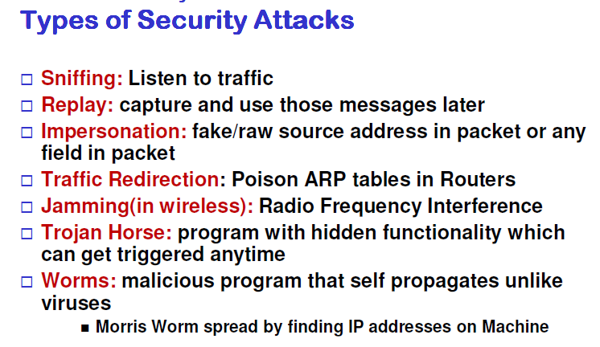

Slide 6
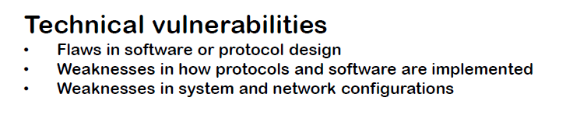

Slide 7
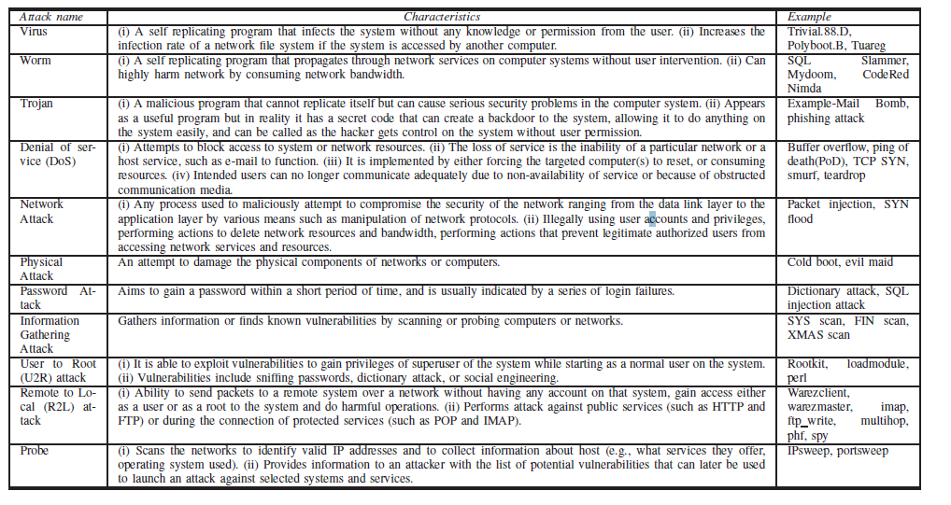

Slide 8
End-User Attacks (Social Engineering )
Social Engineering - refers to a psychological manipulation of people (employees of the company) to perform actions that potentially lead to leak of company's proprietary or confidential information or otherwise can cause damage to company resources, personnel or company image.
Social engineers use various strategies to trick users into disclosing confidential information, data or both.
One of the very common technique used by social engineers is to pretend to be someone else - IT professional, member of the management team, co-worker, insurance investigator or even member of governmental authorities.

Slide 9
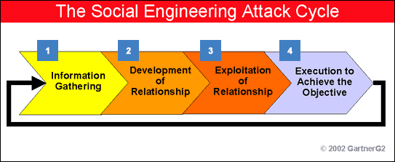
Social Engineering

Slide 10
Phishing Attack
This type of attack use social engineering techniques to steal confidential information - the most common purpose of such attack targets victim's banking account details and credentials.
Phishing attacks tend to use schemes involving spoofed emails send to users that lead them to malware infected websites designed to appear as real on-line banking websites.
Emails received by users in most cases will look authentic sent from sources known to the user (very often with appropriate company logo and localized information) - those emails will contain a direct request to verify some account information, credentials or credit card numbers by following the provided link and confirming the information on-line.
The request will be accompanied by a threat that the account may become disabled or suspended if the mentioned details are not being verified by the user.

Slide 11
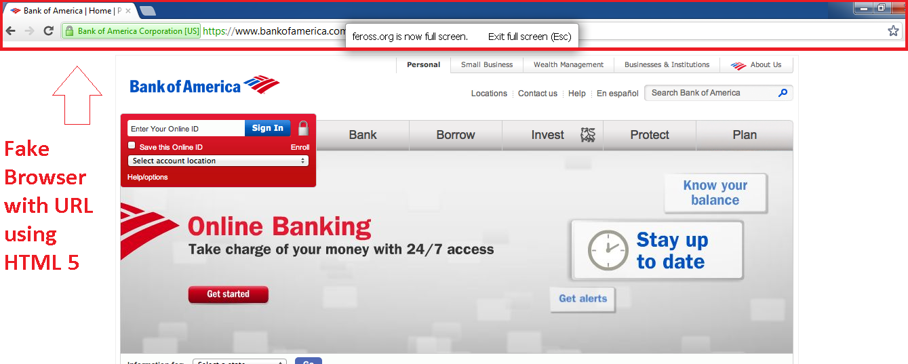
Phishing attack

Slide 12
Social Phishing
Phishing techniques evolved much to include as well social media like Facebook or Twitter - this type of Phishing is often called Social Phishing. The purpose remains the same - to obtain confidential information and gain access to personal files.
The means of the attack are bit different though and include special links or posts posted on the social media sites that attract the user with their content and convince him to click on them. The link redirects then to malicious website or similar harmful content. The websites can mirror the legitimate Facebook pages so that unsuspecting user does not notice the difference.
The website will require user to login with his real information - at this point the attacker collects the credentials gaining access to compromised account and all data on it. Other scenario includes fake apps - users are encouraged to download the apps and install them - apps that contain malware used to steal the confidential information.

Slide 13
Facebook Phishing attacks
are often much more labored - consider following scenario - link posted by an attacker can include some pictures or phrase that will attract the user to click on it.
The user does the click upon which he is redirected to mirror website that ask him to like the post first before even viewing it - user not suspecting any harm in this clicks on "like" button but doesn't realize that the "like" button has been spoofed and in reality is "accept" button for the fake app to access user's personal information.
At this point data is collected and account becomes compromised.

Slide 14
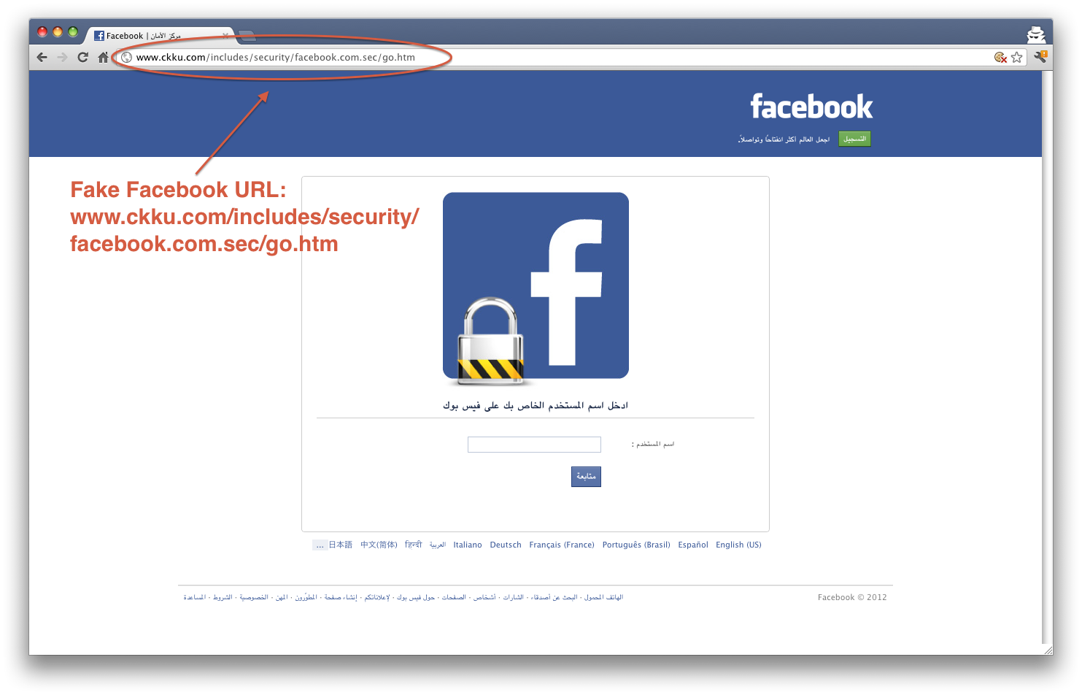
Facebook Phishing attacks

Slide 15
Spear Phishing Attack
This is a type of Phishing attack targeted at specific individuals, groups of individuals or companies.
Spear Phishing attacks are performed mostly with primary purpose of industrial espionage and theft of sensitive information while ordinary Phishing attacks are directed against wide public with intent of financial fraud.
It has been estimated that in last couple of years targeted Spear Phishing attacks are more widespread than ever before

Slide 16
Whaling
Type of Phishing attack specifically targeted at senior executives or other high profile targets within a company.

Slide 17
Vishing (Voice Phishing or VoIP Phishing)
Use of social engineering techniques over telephone system to gain access to confidential information from users.
This Phishing attack is often combined with caller ID spoofing that masks the real source phone number and instead of it displays the number familiar to the Phishing victim or number known to be of a real banking institution.
General practices of Vishing includes pre-recorded automated instructions for users requesting them to provide bank account or credit card information for verification over the phone.

Slide 18

Vishing (Voice Phishing or VoIP Phishing)

Slide 19
The recommendations to protect your company against Phishing and Spear Phishing (countermeasures)
Never open or download a file from an unsolicited email, even from someone you know (you can call or email the person to double check that it really came from them)
Keep your operating system updated
Use a reputable anti-virus program
Enable two factor authentication whenever available
Confirm the authenticity of a website prior to entering login credentials by looking for a reputable security trust mark
Look for HTTPS in the address bar when you enter any sensitive personal information on a website to make sure your data will be encrypted

Slide 20

Be Aware!

Slide 21
Port scanning
An attack type where the attacker sends several requests to a range of ports to a targeted host in order to find out what ports are active and open - which allows him then to exploit known service vulnerabilities related to specific ports.
Port scanning can be used by the malicious attackers to compromise the security.
As well by the IT Professionals to verify the network security.

Slide 22
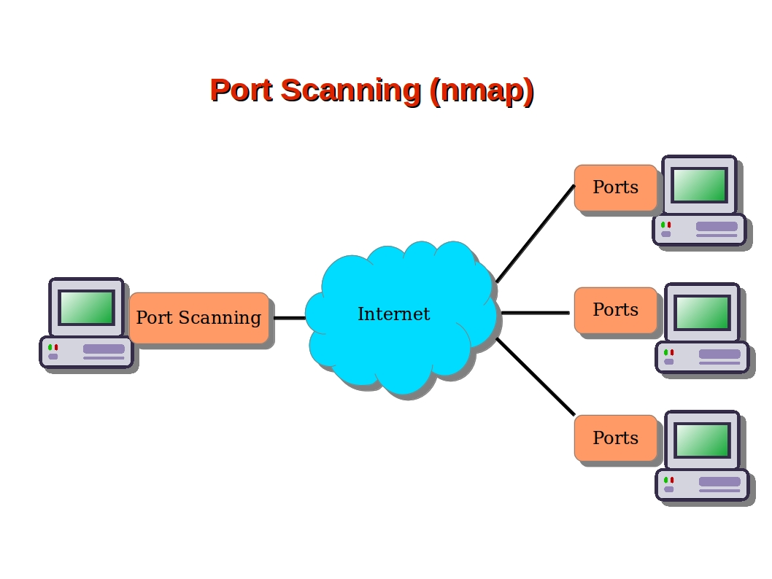
Port Scanning
nmap 192.168.0.1
nmap www.hostname.com (basic scan)
nmap –p 80 192.168.0.1(port 80 scan)
nmap –p 1-200 192.168.0.1(ange of ports scan)
nmap –F 192.168.0.1 (Fast scan)
nmap –p– 192.168.0.1 (all 1-65535 ports)
Chapter 4. Port Scanning Overview | Nmap Network Scanning

Slide 23
Detection of Port Scan and block
The condition for detection is fulfilled when it detects more than 4 local ports being accesses by same remote IP within 200 seconds

Slide 24
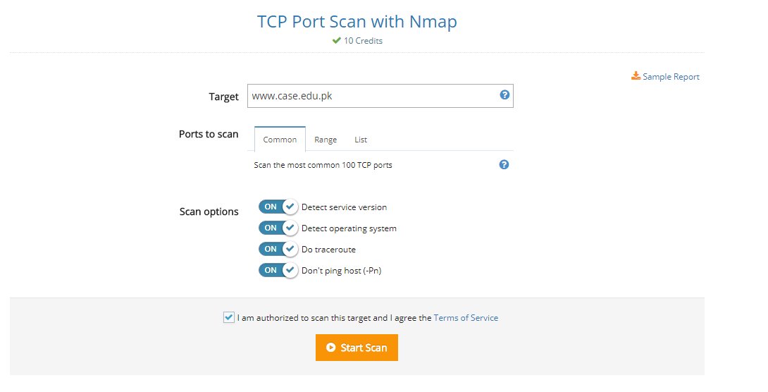
TCP Port Scan with Nmap Result
https://pentest-tools.com/network-vulnerability-scanning/tcp-port-scanner-online-nmap

Slide 25
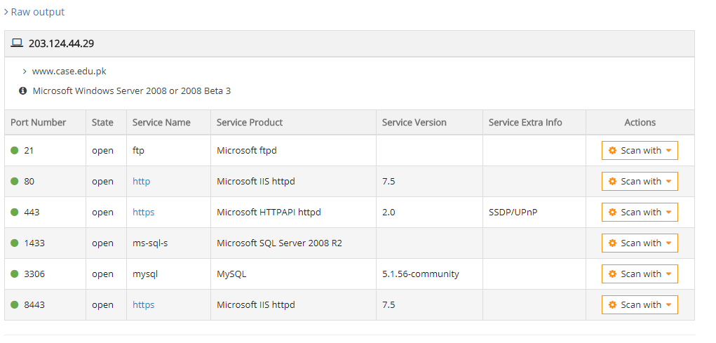

Slide 26
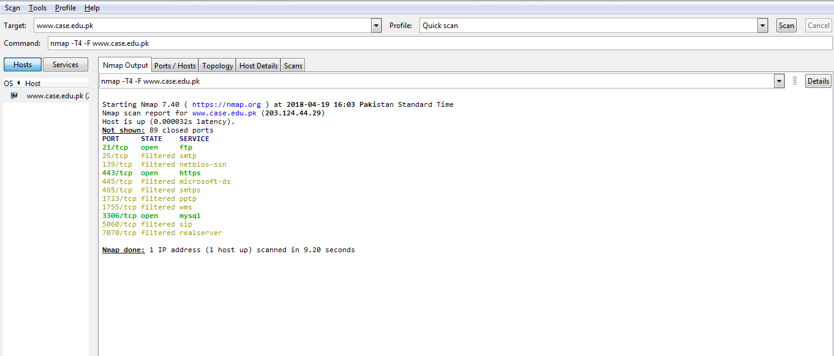
Scanning using zenmap

Slide 27
Spoofing
technique used to masquerade a person, program or an address as another by falsifying the data with purpose of unauthorized access
IP Address spoofing
ARP spoofing (ARP Poisoning)
DNS spoofing (DNS Cache Poisoning)
Email spoofing
Search engine poisoning

Slide 28
IP Address spoofing
Process of creating IP packets with forged source IP address to impersonate legitimate system

Slide 29
IP Address spoofing tools
HPing v2.0.0
Nemesis v1.4 beta3
Colasoft Packet Builder v1.0
Colasoft Packet Player v1.1
PacketExcalibur v1.0.2
Scapy v2.0.0.10
Spoofer v0.5
Notes:
ip=IP()
ip.src=RandIP()
ip.dst =’ 192.168.1.100′
icmp=ICMP()
icmp.type=8
icmp.code=0
send(ip/icmp)

Slide 30
ARP spoofing (ARP Poisoning)
Process of sending faked ARP messages in the network.
The purpose of this spoofing is to associate the MAC address with the IP address of another legitimate host causing traffic redirection to the attacker host

Slide 31
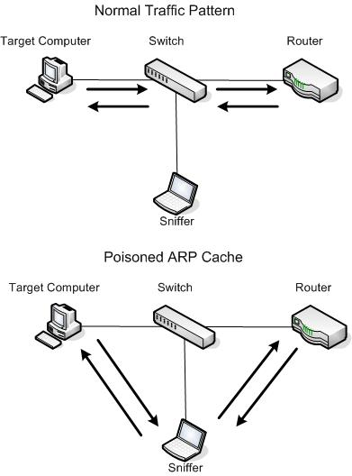
ARP spoofing (ARP Poisoning)

Slide 32
Countermeasure
Use static ARP tables
NOT allowing 1 MAC per IP address

Slide 33
DNS spoofing (DNS Cache Poisoning)
attack where the wrong data is inserted into DNS Server cache, causing the DNS server to divert the traffic by returning wrong IP addresses as results for client queries

Slide 34
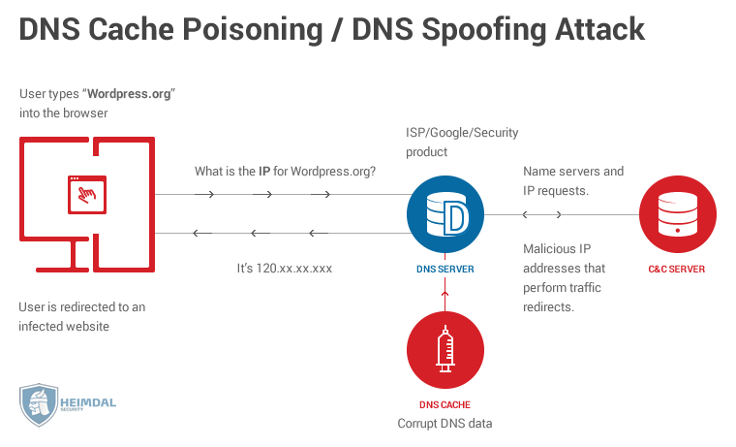
DNS spoofing (DNS Cache Poisoning)

Slide 35
Email spoofing
process of faking the email's sender "From" field in order to hide real origin of the email. This type of spoofing is often used in spam mail or during Phishing attack
Notes:
Emkei.cz
http://send-email.org
http://www.mailinator.com
http://deadfake.com
http://theanonymousemail.com
http://www.anonymailer.net

Slide 36
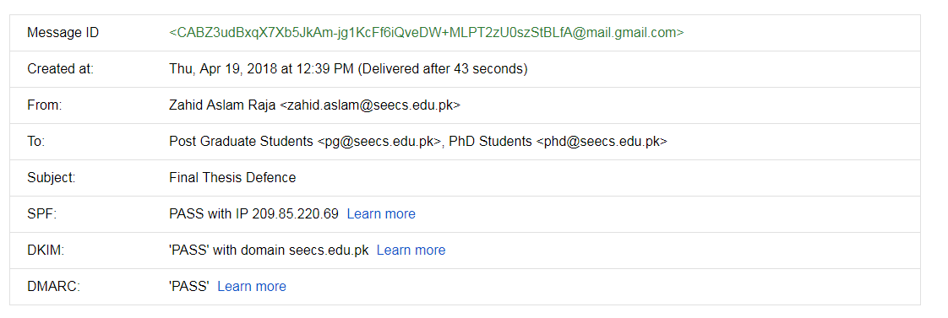
Gmail security, Spoofed and fake mail

Slide 37
Search engine poisoning
attackers take here advantage of high profile news items or popular events that may be of specific interest for certain group of people to spread malware and viruses.
This is performed by various methods that have in purpose achieving highest possible search ranking on known search portals by the malicious sites and links introduced by the hackers

Slide 38
Network Sniffing (Packet Sniffing)
process of capturing the data packets travelling in the network. Network sniffing can be used both by IT Professionals to analyze and monitor the traffic for example in order to find unexpected suspicious traffic, but as well by perpetrators to collect data send over clear text that is easily readable with use of network sniffers (protocol analyzers).
Best countermeasure against sniffing is the use of encrypted communication between the hosts.

Slide 39
Denial of Service Attack (DoS Attack) and Distributed Denial of Service Attack (DDoS Attack)
attack designed to cause an interruption or suspension of services of a specific host/server by flooding it with large quantities of useless traffic or external communication requests.
When the DoS attack succeeds the server is not able to answer even to legitimate requests any more - this can be observed in numbers of ways: slow response of the server, slow network performance, unavailability of software or web page, inability to access data, website or other resources.
Distributed Denial of Service Attack (DDoS) occurs where multiple compromised or infected systems (botnet) flood a particular host with traffic simultaneously

Slide 40
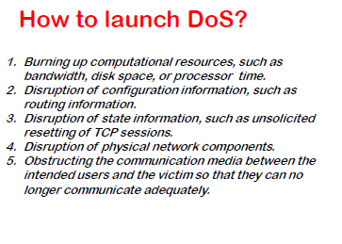

Slide 41
Common DoS attacks (ICMP flood attack (Ping Flood) )
the attack that sends ICMP ping requests to the victim host without waiting for the answer in order to overload it with ICMP traffic to the point where the host cannot answer to them any more either because of the network bandwidth congestion with ICMP packets (both requests and replies) or high CPU utilization caused by processing the ICMP requests.
Easiest way to protect against any various types of ICMP flood attacks is either to disable propagation of ICMP traffic sent to broadcast address on the router or disable ICMP traffic on the firewall level.

Slide 42
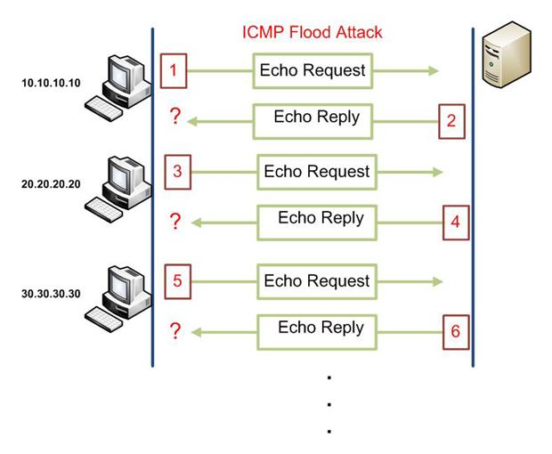
ICMP flood attack (Ping Flood)

Slide 43
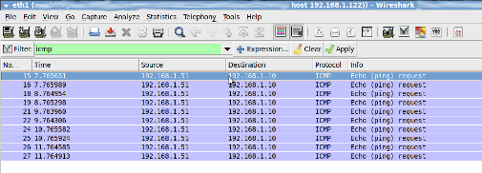
ICMP flood

Slide 44
Ping of Death (PoD)
Attack involves sending a malformed or otherwise corrupted malicious ping to the host machine - this can be for example PING having size bigger, than usual which can cause buffer overflow on the system that lead to a system crash.
Notes:
POD (Ping of Death) is a type of attack at computer in a network that involves sending of a larger size malicious ping to a computer. A ping is normally 64 bytes in size. Many computers can not handle larger than the maximum IP packet size, which is 65,535 bytes. Sending a ping of this size can crash the target computer.

Slide 45
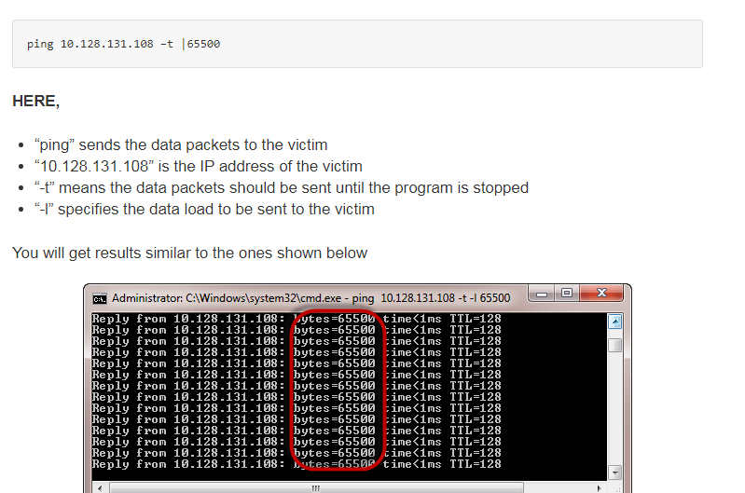
Ping of Death (PoD)

Slide 46
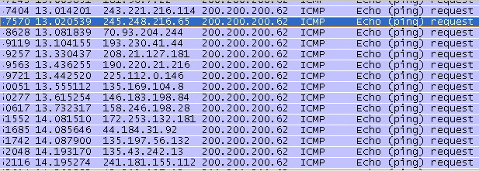
.pcap dump(multiple sources)

Slide 47
Smurf Attack
works in the same way as Ping Flood attack with one major difference that the source IP address of the attacker host is spoofed with IP address of other legitimate non malicious computer.
Such attack will cause disruption both on the attacked host (receiving large number of ICMP requests) as well as on the spoofed victim host (receiving large number of ICMP replies).

Slide 48
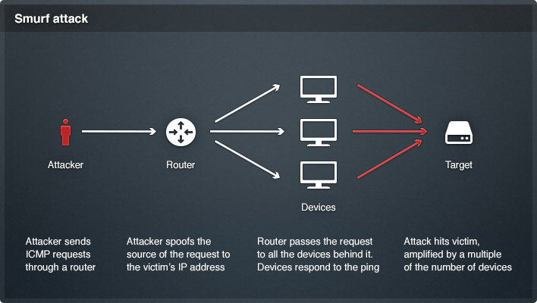
Smurf Attack

Slide 49
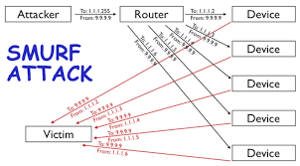
Smurf Attack

Slide 50
SYN flood attack
attack exploits the way the TCP 3-way handshake works during the TCP connection is being established. In normal process the host computer sends a TCP SYN packet to the remote host requesting a connection. The remote host answers with a TCP SYN-ACK packet confirming the connection can be made. As soon as this is received by the first local host it replies again with TCP ACK packet to the remote host. At this point the TCP socket connection is established.
During the SYN Flood attack the attacker host or more commonly several attacker hosts send SYN Packets to the victim host requesting a connection, the victim host responds with SYN-ACK packets but the attacker host never respond back with ACK packets - as a result the victim host is reserving the space for all those connections still awaiting the remote attacker hosts to respond - which never happens.
This keeps the server with dead open connections and in the end effect prevent legitimate host to connect to the server any more.

Slide 51
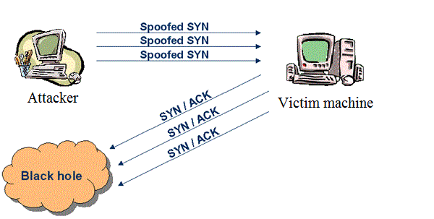
SYN flood attack

Slide 52
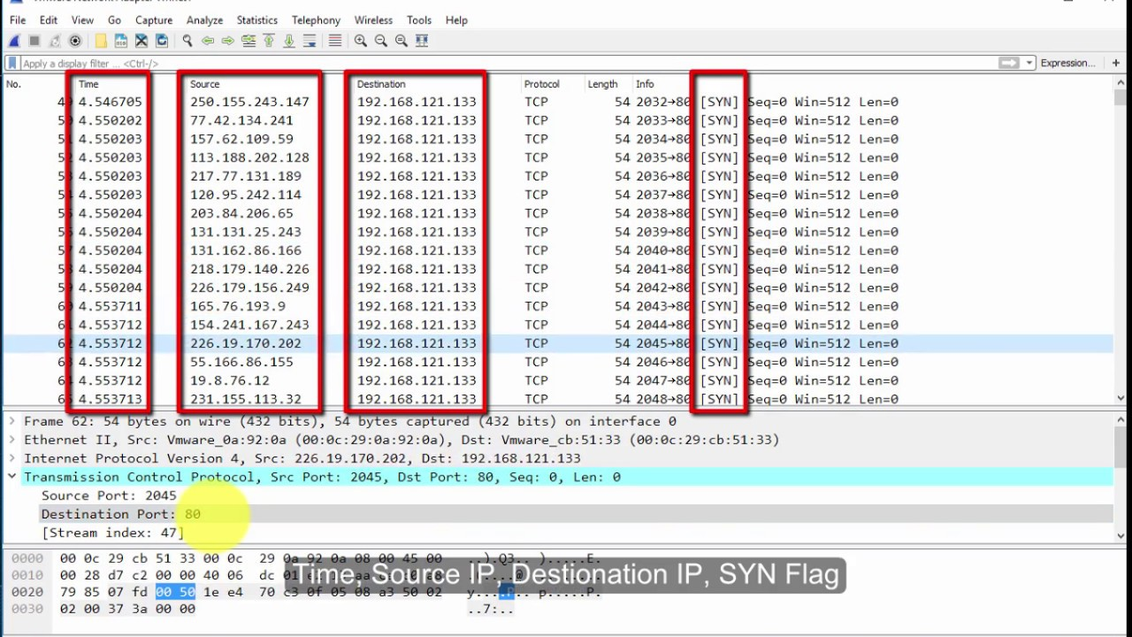
SYN flood

Slide 53
Buffer Overflow Attack
In this type of attack the victim host is being provided with traffic/data that is out of range of the processing specs of the victim host, protocols or applications - overflowing the buffer and overwriting the adjacent memory..
One example can be the mentioned Ping of Death attack - where malformed ICMP packet with size exceeding the normal value can cause the buffer overflow.

Slide 54
Botnet
A collection of compromised computers that can be controlled by remote perpetrators to perform various types of attacks on other computers or networks.
A known example of botnet usage is within the distributed denial of service attack where multiple systems submit as many request as possible to the victim machine in order to overload it with incoming packets.
Botnets can be otherwise used to send out spam, spread viruses and spyware and as well to steal personal and confidential information which afterwards is being forwarded to the botmaster

Slide 55
Man-in-the-middle Attack
The attack is form of active monitoring or eavesdropping on victims connections and communication between victim hosts.
This form of attack includes as well interaction between both victim parties of the communication and the attacker - this is achieved by attacker intercepting all part of the communication, changing the content of it and sending back as legitimate replies.
The both speaking parties are here not aware of the attacker presence and believing the replies they get are legitimate.
For this attack to success the perpetrator must successfully impersonate at least one of the endpoints - this can be the case if there are no protocols in place that would secure mutual authentication or encryption during the communication process.

Slide 56
Session Hijacking Attack
Attack targeted as exploit of the valid computer session in order to gain unauthorized access to information on a computer system.
The attack type is often referenced as cookie hijacking as during its progress the attacker uses the stolen session cookie to gain access and authenticate to remote server by impersonating legitimate user.
https://scotthelme.co.uk/advanced-session-hijacking/(useful )

Slide 57
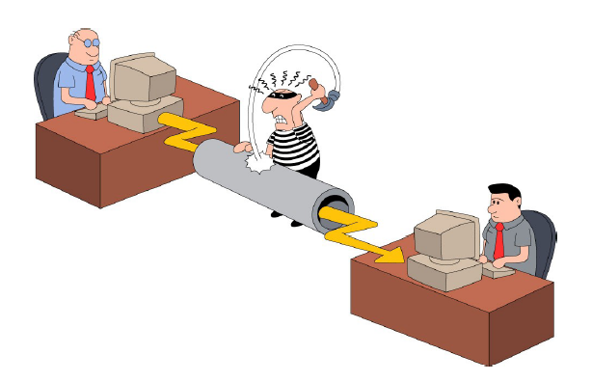
Session Hijacking Attack

Slide 58
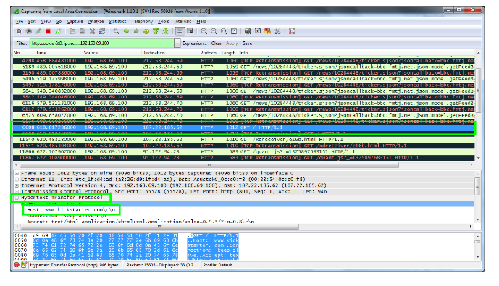
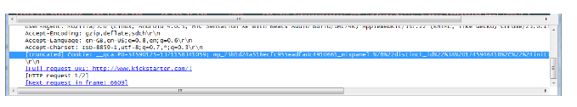
How to do Session hijacking

Slide 59
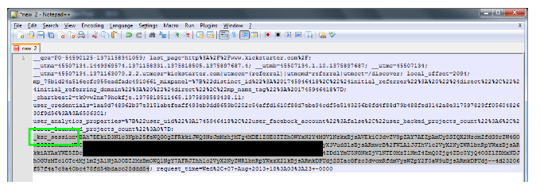
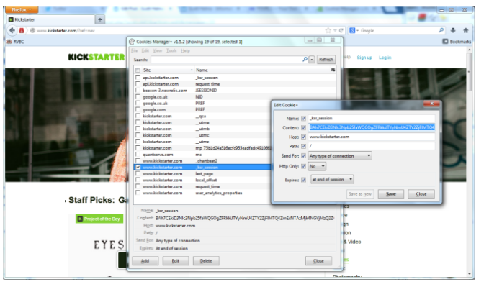
How to do Session hijacking

Slide 60
Session hijacking how to prevent ?
Require the use of SSL encryption on all pages of your website, or at least those pages that are used to transmit cookies.
Provide a VPN to your users when they are away from the office.
Re-authenticate regularly

Slide 61
SHJ (Methods)
Source routing: attacker can actually use source routing in such a way that the data is being transferred between client and server through attacker. In that case attacker can see the data being exchanged and can see the Initial Sequence Number.
Man in the middle attack: By Logically placing himself between the server and client, an attacker can similarly see the data connection going through him.(ARP poisoning )
Attacker can also use ICMP redirect to spoof himself as gateways so that data can be passed through him.
Attacker can also hijack the TCP session by not predicting or looking for initial sequence number instead he can let the user establish a successful connection and then spoofing himself as a client by changing his MAC address with that of the original Host, attacker can send RST bit set to the server to reset the connection and starting a whole new connection from TCP three way handshaking and exchanging the new sequence numbers.

Slide 62
Bluetooth related attacks (Bluesnarfing )
This kind of attack allows the malicious user to gain unauthorized access to information on a device through its Bluetooth connection.
Any device with Bluetooth turned on and set to "discoverable" state may be prone to bluesnarfing attack.

Slide 63
Bluejacking
this kind of attack allows the malicious user to send unsolicited (often spam) messages over Bluetooth to Bluetooth enabled devices.

Slide 64
Bluebugging
hack attack on a Bluetooth enabled device. Bluebugging enables the attacker to initiate phone calls on the victim's phone as well read through the address book, messages and eavesdrop on phone conversations.

Slide 65
Any Questions ?

